Slide 1

Review and Intro to
Neural Networks
Advanced Track Workshop #1
ACM AI
Slides: https://tinyurl.com/advtrack-fall19-week3

Slide 2
Resources
ACM AI
Slides: https://tinyurl.com/advtrack-fall19-week3
Github: https://github.com/uclaacmai
Membership Portal Code: atrack1

Slide 3



Officers Helping w/ Advanced Track
ACM AI
Ben Limpanukorn
Vaishnavi Tipireddy
Megha Ilango
Aaron Phillip

Slide 4
Icebreaker
Come up with something your whole group has in common that none of the other groups would have in common
Most obscure commonality wins!

Slide 5
Overview and Logistics
ACM AI

Slide 6
Overview of ACM AI
ACM AI
Workshops
Beginner Track
Advanced Track
Advanced ++ (next quarter)
Outreach
Demystifying AI
Teach LA AI
Projects
Mission ML
Deep Fake Detection
Watch Greeting

Slide 7
Beginner vs. Advanced Workshops
ACM AI
Beginner
Introduction to basic machine learning methods, such as linear and logistic regression
Explains mathematical concepts and motivations
Introduces neural networks
No prior knowledge expected
Advanced
Neural Networks
Focused on Deep Learning
Expected prior knowledge of working with data in Python and basic background in machine learning

Slide 8
Advanced Track Tentative Schedule
ACM AI
Week 3: Logistic Regression Review + Neural Networks Intro
Week 4: Neural Network Concepts + Applications
Week 5: Neural Network Applications
Week 6: Convolutional Neural Network Concepts
Week 7: Convolutional Neural Network Applications
Week 8: Recurrent Neural Network Concepts
Week 9: Recurrent Neural Network Applications
Every Friday 6:00-8:00 PM in Geology 4660
Notes:
Week 5: hyperparameters, optimization

Slide 9
Expected Prior Knowledge
ACM AI
Comfortable with coding
Basic machine learning knowledge
Basic knowledge of working with data, i.e. Numpy arrays

Slide 10
Today’s Contents
ACM AI
Review of machine learning
Linear + Logistic Regression
Introduction to neural networks

Slide 11
ACM AI
Questions?

Slide 12
2. Review of Linear/Logistic Regression
ACM AI
Notes:
Beginning with a quick review of the beginner track from spring quarter linear and logistic regression.
People with prior experience might already be familiar, but we want to ease into the workshops.

Slide 13
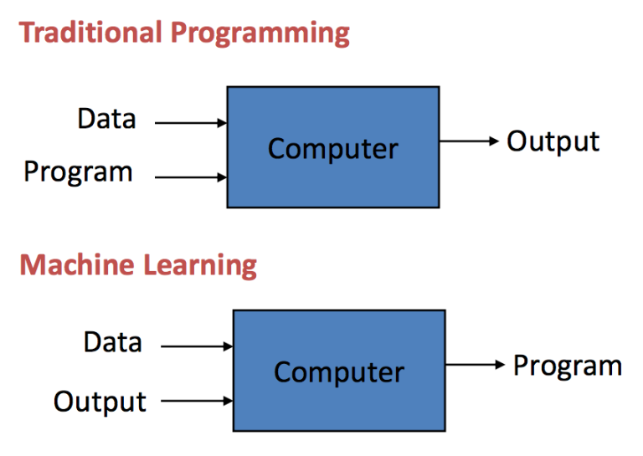
Machine Learning Refresher
ACM AI
Machine Learning is using data to teach computers how to answer our questions
Notes:
How does machine learning differ from other areas of computer science and programming?

Slide 14
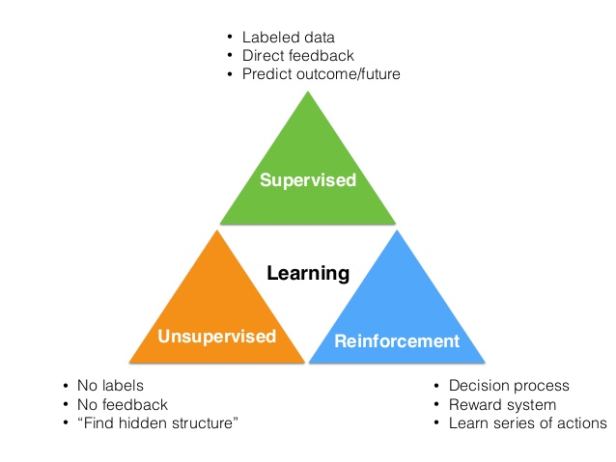
Notes:
Some examples of each type of machine learning:
Unsupervised:
Applications:
- Data mining - finding patterns
- medical imaging - image segmentation
Algorithms:
- GANs
- Autoencoders
Reinforcement Learning:
- Agents taking actions, decision-making
- e.g. playing video games, maximizing the score
Supervised:
- The focus of this course
- CNNs, RNNs
- classification, regression

Slide 15
Key elements of Machine Learning
ACM AI
Representation: Represent knowledge.
Eg: decision trees, neural networks
Evaluation: Evaluate candidate programs (hypotheses).
Eg: Cost, margin, entropy, squared error
Optimization: Candidate programs are generated (search process)
Eg: combinatorial optimization, gradient descent
Notes:
Representation: how to represent knowledge EG include decision trees, neural networks, support vector machines, model ensembles
Evaluation: the way to evaluate candidate programs (hypotheses) EG include accuracy, prediction and recall, squared error, likelihood, posterior probability, cost, margin, entropy
Optimization: the way candidate programs are generated known as the search process. EG combinatorial optimization, convex optimization, constrained optimization.

Slide 16

Classification vs Regression
Prob. for #0
Prob. for #1
Prob. for #9
Identifying a digit
Classification
Model
[0.05, 0.01, …, 0.94]
Predicting house prices
[3, 2000, 1]
Linear Regression
Model
[198000]
Notes:
Add definition of classification and regression
Add examples

Slide 17
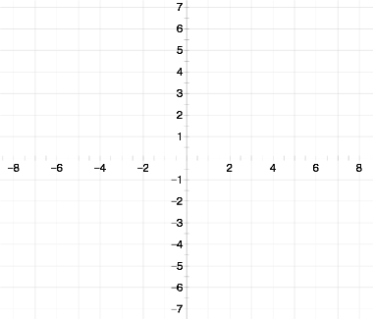
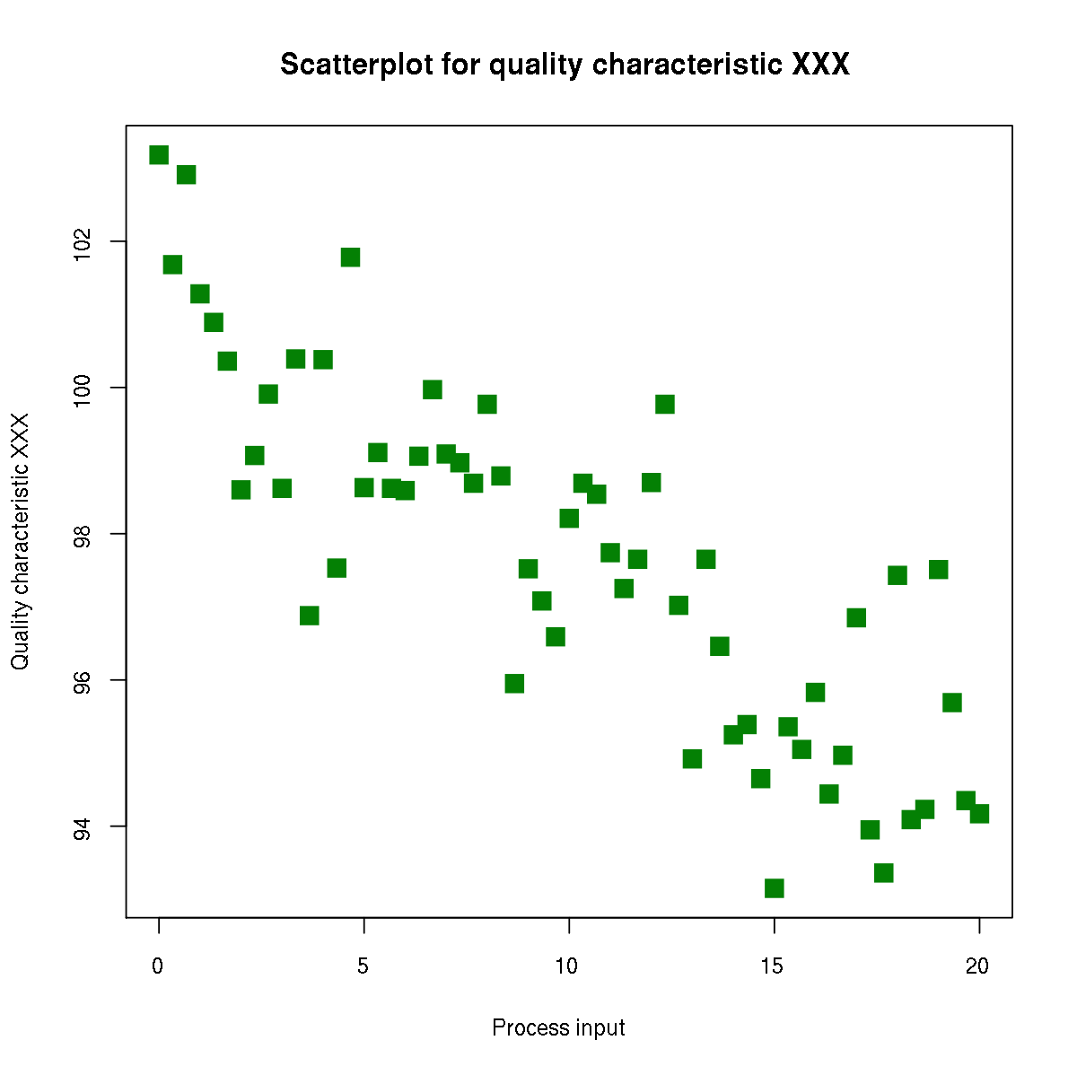
What is linear regression?
Goal: to find the equation of a line that best fits our data
We want to be able to use this line to predict outputs from given inputs
Notice that the outputs are continuous
Classification or regression?
Best-fit line for plotted data

Slide 18
Hypothesis Function
Outputs are a linear representation of the inputs
Single feature
h(x) = w₀ + w₁x
Multiple features
h(x₁...x_{n}) = w₀ + w₁x₁+ w₂x ₂+...+ w_{n}x_{n}
Weights: w
We change the weight parameters in order to come up with the best hypothesis that fits our data
Multiple features
We have n features instead of 1, that means we have n features for each x

Slide 19
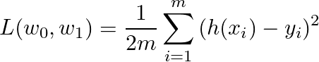
Cost Function
½ of the mean of the squares of the differences between predictions and actual outputs
Mean squared error function
½ is there for convenience when taking derivatives of this formula

Slide 20
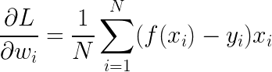
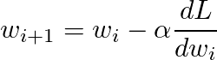
Gradient Descent
Our goal is to minimize the loss
We do this by adjusting the values for our weight matrices and bias terms
Intuitively, we want to find out the impact of a particular weight on the overall error.
Adjust the current weights:

Slide 21

Gradient Descent (cont.)
Iterations of gradient descent continue until the cost function converges to a local minimum

Slide 22
Review
How is machine learning different from traditional computer programming?
What is linear regression?
How is the loss function used in gradient descent?

Slide 23
Logistic Regression
ACM AI
Machine learning model used primarily for problem spaces where a selection from a group of categories/classes is needed.
Example Problem Spaces
Cancer Detection (Binary 0/1)
Digit Classification (10 Classes)
Object Classification (Multiple Classes)

Slide 24
Logistic Regression
ACM AI
Very similar to linear regression:
Y = Wx + b
Logistic Regression Equation
Y = σ(Wx + b)
W and x are both vectors
For binary classification: σ = Sigmoid Function
For Multi-class classification: σ = Softmax Function

Slide 25
Activation function
ACM AI
Logistic Regression is just linear regression, with an activation function
The activation function is used to take the continuous output of the linear regression, and separate the result into classes in a non-linear fashion, whether it be two classes (sigmoid function) or multiclass (softmax function)

Slide 26
ACM AI
Questions?

Slide 27
4. Review
ACM AI

Slide 28
Review
What is the difference between regression and classification?
What is the difference between linear and logistic regression?

Slide 29
5. Introduction to
Neural Networks
ACM AI

Slide 30

Neural Networks
ACM AI
Notes:
What is a neural network?

Slide 31
Artificial Neuron
FEATURES
# Bathrooms
# Bedrooms
# Sq. feet
WEIGHTS
Represents a “Neuron”
Logistic Regression
Weights Vector w
Activation Function σ
Recall: Logistic Regression Equation
Y = σ(xw + b)
Y
Notes:
Same process as logistic regression, just applied many times

Slide 32
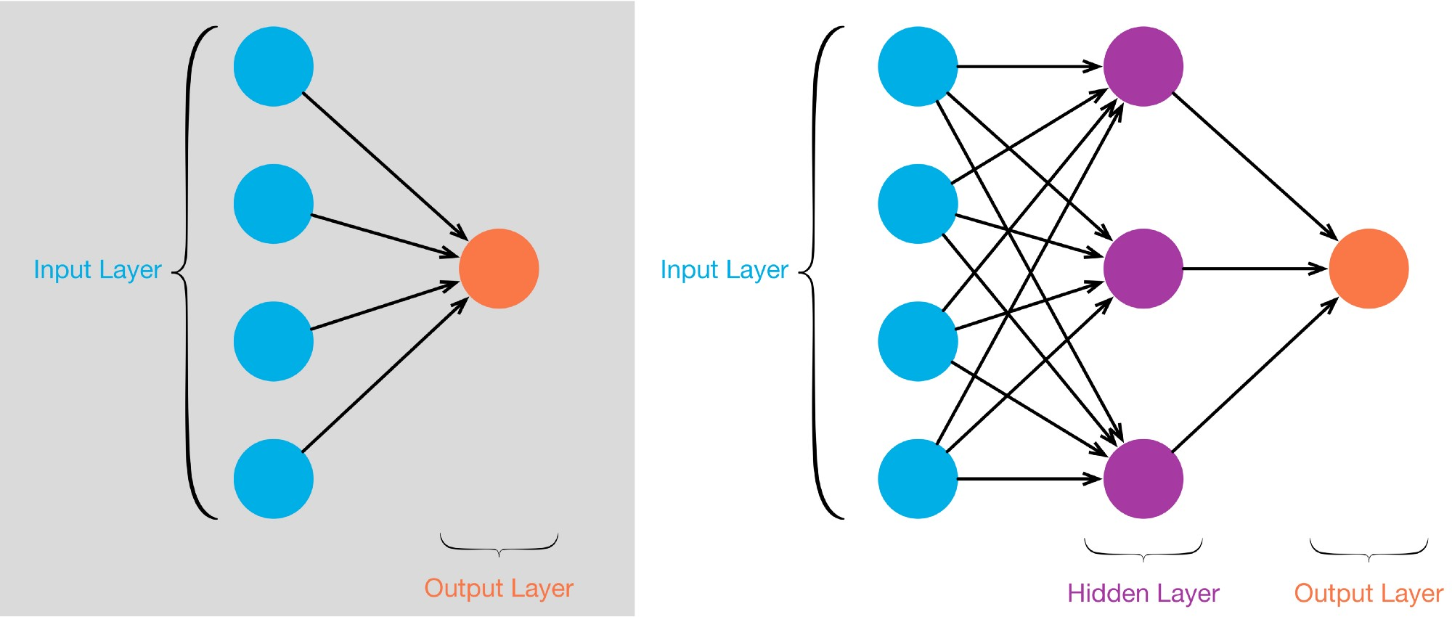
Perceptron
Single layer NN
Sigmoid Neurons

Slide 33
So why bother?
Neural nets allow us to model more complex data
Training on a neural net gives us a greater ability to model that information
More complex architectures help us model relationships that linear classifiers cannot fully represent

Slide 34
Next Time: Neural Networks Pipeline
Define architecture
Pass inputs forward, get prediction
Compute loss
function of prediction and actual label
Perform gradient descent to get weight adjustments
Propagate adjustments backwards
backpropagation, chain rule for derivatives

Slide 35
ACM AI
Questions?

Slide 36
5. Upcoming Events
ACM AI

Slide 37
Advanced Track Meeting Next Week
ACM AI
When: Friday, October 25 from 6:00 - 8 PM
Where: Geology 4660
Next week, we’ll be continuing with neural networks

Slide 38
Please Fill Out Our Feedback Form!
ACM AI

Slide 39
Thank you all for coming!
Join our Facebook group
ACM AI

